Slide 1


Azure functions and Xamarin
Laurent Bugnion, Senior Cloud Developer Advocate

Slide 2
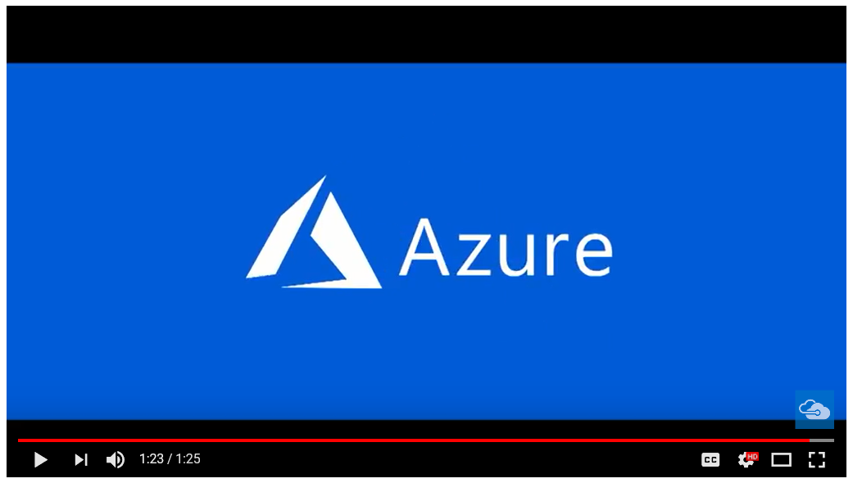

Slide 3

Cloud Developer Advocates
https://developer.microsoft.com/en-us/advocates
Twitter List
http://bit.ly/azdevlist
Hashtag
#azdev
Account:
@azureadvocates
Aaron Wislang
Abel Wang
Alena Hall
Anthony Chu
Ashley McNamara
Asim Hussain
Bernd Verst
Brian Benz
Brian Clark
Brian Ketelsen
Brian Peek
Bridget Kromhout
Bryan Liston
Burke Holland
Burke Holland
Cecil Phillip
Damian Brady
Donovan Brown
Erik St. Martin
Jasmine Greenaway
Jeremy Likness
Jessica Frazelle
John Papa
Kris Nova
Laurent Bugnion
Matthew Soucoup
Maxime Rouiller
Paige Bailey
Prashant Sridharan
Ruth Yakubu
Sarah Drasner
Scott Cate
Seth Juarez
Shayne Boyer
Simona Cotin
Steven Murawski
Tim Heuer
Vadim Karpusenko
Zachary Deptawa

Slide 4

Resources (Functions)
Github repo http://gslb.ch/c4s-xamarinexpertday17 Azure Functions introduction blog http://gslb.ch/c14s-xamarinexpertday17
Azure Functions Docs overview http://gslb.ch/c10s-xamarinexpertday17
Quickstart, portal http://gslb.ch/c15s-xamarinexpertday17
Quickstart, Visual Studio http://gslb.ch/c16s-xamarinexpertday17
Azure Storage Explorer http://gslb.ch/c16s-xamarinexpertday17
Free Azure account http://gslb.ch/c17s-xamarinexpertday17
Azure Mobile Center http://gslb.ch/c18s-xamarinexpertday17
Azure Mobile Center documentation http://gslb.ch/c19s-xamarinexpertday17
Getting started with Cosmos DB http://gslb.ch/c7s-xamarinexpertday17
Cloud Developer Advocates http://gslb.ch/c6s-xamarinexpertday17
@LBugnion | http://galasoft.ch | LBugnion@microsoft.com

